Slide 1
Blockchain as a Service
Cale Teeter – SDE/DX

Slide 2
Blockchain evolving from simple ledgers, to cryptlets that fetch trusted and agreed-upon external data needed to execute Smart Contracts
Blockchain 3.0
+ Cloud Servicing
Multilayer Middleware
+ Cryptlets
Blockchain 2.0
+ Smart Contracts
Logic Tier
Microsoft Innovation
Blockchain 1.0
Simple Ledgers that
record transactions
Smart Contracts are unable to access external data or events based on time or market conditions. Calling code or data outside of a Smart Contract or blockchain breaks the general trust barrier and authenticity of transactions. Cryptlets will allow the blockchain to access external data securely, while maintaining the integrity of the blockchain.

Slide 3
Tenets of our
Strategy
FAIL FAST & CHEAP
in a development test environment
MIX & MATCH
from the best available blockchain technologies
CREATE & INNOVATE
by building solutions on blockchain quickly
SHARE SOLUTIONS
through a worldwide distributed platform
PROVISION
with one-click to test & iterate

Slide 4





Microsoft will execute on its strategy in three steps: Learning from POCs, growing the ecosystem, and building key middleware
POCs
1 - Build and learn from key customer-driven POCs built on top various blockchain technologies
Banking, Capital Markets
Discrete Manufacturing
Retail & CPG
Healthcare
Government
Professional Services & Support
ISVs &
Customers
Industry Solutions
Horizontal SaaS & Adapters
1st Party
3rd Party
3rd Party
3rd Party
…..
2 - Grow the blockchain marketplace ecosystem & artifacts together with our partners & customers
Distributed Ledger Gateway Services
Identity & Key Services
Crypto Services
ML & BI
Services
Blockchain Marketplace
Middleware
CryptoDelegate & Cryptlet architecture (secure containers, attestation, etc.)
3 - Develop key Azure blockchain middleware services to ensure the infrastructure is enterprise ready
Blockchain
Tools
Distributed Ledger Stacks
Smart Contract-based
UTXO + others
Blockchain Virtual Machine
Adapters
Base Platform
3rd Party DL stack A
3rd Party DL stack B…
3rd Party DL stack C…
1st Party DL Stack
Azure
Blockchain Resource Provider

Slide 5
1 – Create a tight feedback loop between POCs & MS engineering to enable quick iterations on our offerings
POCs
POCs will enable Microsoft to learn quickly, discover customer needs, and galvanize our partners…
…influencing BaaS product design and long-term value delivery while saving rework for everyone
Blockchain Platform
Engineering
Distributed Ledger Stacks
Azure

Slide 6

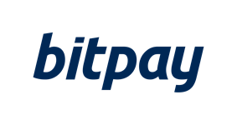



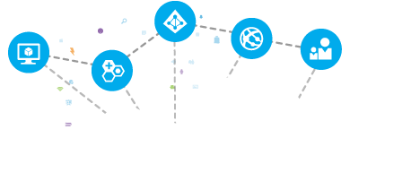
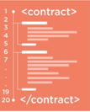
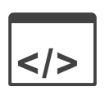



2 – Drive partner innovation and scale by providing blockchain tools and pre-configured solutions through our marketplaces
Promote engagement and innovation by onboarding ISVs into Azure Marketplace and AppSource
Enable customers and partners to discover, publish and transact blockchain components and services from smart contracts to complete SaaS offerings
  Azure Marketplace and AppSource with 3rd party solutions, smart contracts, and other blockchain components
cryptlet
cryptlet

Slide 7
3 – Build enterprise-ready blockchain middleware
POCs
The Blockchain Middleware will provide core services, which will help users create and build on top of blockchains within Azure
The core services can be broken down into the following:
  Identity and Certificate Services – Helps with authentication, authorization, access, and lifecycle management.
  Encryption Services – Provides encryption for blockchain transactions and fields
  Cryptlet Services – Provides runtime for cryptlets and communication between blockchain and cryptlet trusted host
  Blockchain Gateway Services – Provides communication between multiple blockchains
  Data Services – Rich data services, such as analytics, auditing, and machine learning
  Management and Operations – Tools for deployment and management
Banking, Capital Markets
Discrete Manufacturing
Retail & CPG
Healthcare
Government
Professional Services & Support
Industry Solutions
Horizontal SaaS & Adapters
1st Party
3rd Party
3rd Party
3rd Party
…..
Distributed Ledger Gateway Services
Identity & Key Services
Crypto Services
ML & BI
Services
Middleware
CryptoDelegate & Cryptlet architecture (secure containers, attestation, etc.)
Distributed Ledger Stacks
Smart Contract-based
UTXO + others
Blockchain Virtual Machine
Adapters
Base Platform
3rd Party DL stack A
3rd Party DL stack B…
3rd Party DL stack C…
1st Party DL Stack
Azure
Blockchain Resource Provider

Slide 8















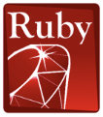







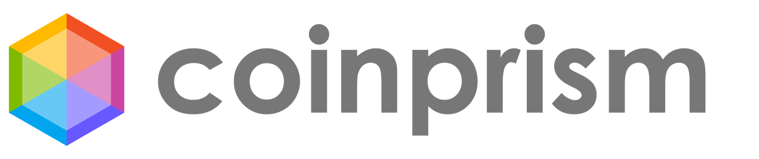







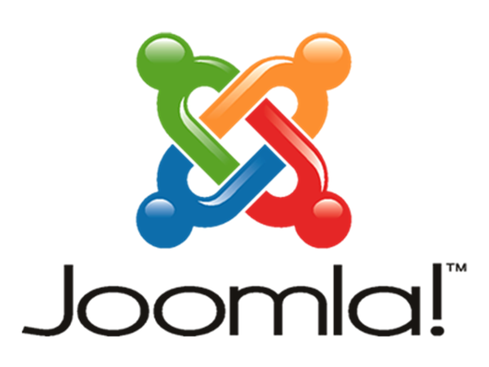





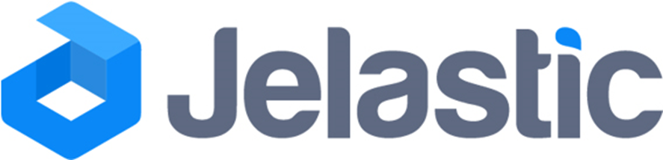




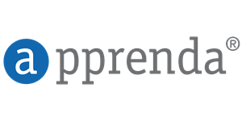









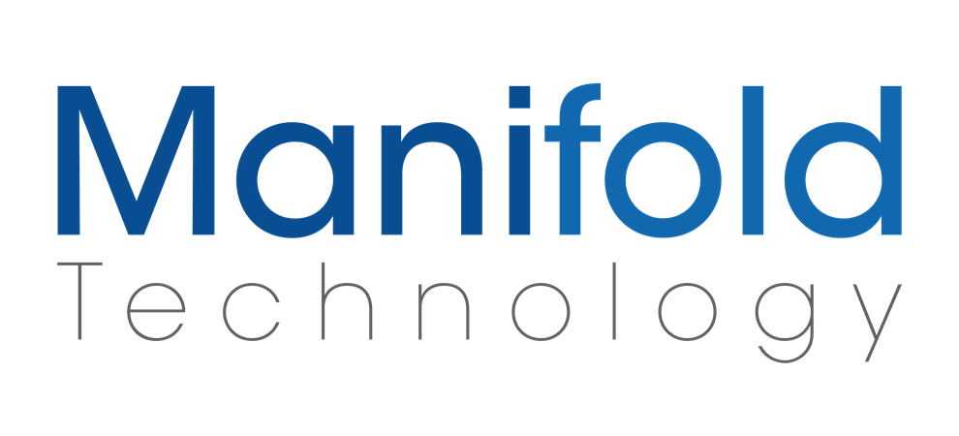
Microsoft Azure | An Open Cloud
Infrastructure
Databases
App Frameworks
Hyper Scale
Enterprise Grade
Hybrid
We’ve delivered an open, broad, and flexible cloud across the stack
SQL Server
Azure BaaS
+Hundreds of community supported images on VM Depot
Applications
Management
Clients
Web App Gallery
Dozens of .NET & PHP CMS and Web apps
Notes:
Open source technologies will serve as the building blocks for this ecosystem
Project “Bletchley” will remain open to all protocols, consensus algorithms, databases, and virtual machines
Project “Bletchley” is a modular framework, which allows users to select the combination of technologies that best fits their needs

Slide 9
How do partners get started?

Slide 10
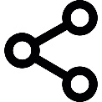
SIGN UP FOR AN AZURE ACCOUNT
https://azure.microsoft.com/en-us/solutions/blockchain/
How do you
get started?
DEPLOY DEV/TEST BLOCKCHAIN ENVIRONMENT TO LEARN
Marketplace Offerings: https://azure.microsoft.com/en-us/marketplace/?term=blockchain
Azure Quickstart Templates:
https://github.com/Azure/azure-quickstart-templates
SETUP BLOCKCHAIN NETWORK ON AZURE
Create your custom private/consortium network
https://azure.microsoft.com/en-us/documentation/templates/
START BUILDING OUT SCENARIOS AND APPS
Develop your own Smart Contracts and Dapps using Visual Studio Solidity Extension: https://visualstudiogallery.msdn.microsoft.com/96221853-33c4-4531-bdd5-d2ea5acc4799/
CONNECT WITH BLOCKCHAIN ENGINEERING TEAM
Join Blockchain Azure Advisors group on Yammer: http://aka.ms/AzureAdvisors

Slide 11
Build enterprise-ready blockchain middleware
Banking, Capital Markets
Discrete Manufacturing
Retail & CPG
Healthcare
Government
Media
The Blockchain Middleware will provide core services, which will help users create and build on top of blockchains within Azure
The core services can be broken down into the following:
  Identity and Certificate Services – Helps with authentication, authorization, access, and lifecycle management.
  Encryption Services – Provides encryption for blockchain transactions and fields
  Cryptlet Services – Provides runtime for cryptlets and communication between blockchain and cryptlet trusted host
  Blockchain Gateway Services – Provides communication between multiple blockchains
  Data Services – Rich data services, such as analytics, auditing, and machine learning
  Management and Operations – Tools for deployment and management
Professional Services & Support
Industry Solutions
Horizontal SaaS & Adapters
1st Party
3rd Party
3rd Party
3rd Party
…..
Distributed Ledger Gateway Services
Identity & Key Services
Crypto Services
ML & BI
Services
Middleware Tier
CryptoDelegate and Cryptlet architecture (secure containers, attestation, etc.)
Distributed Ledger Stacks
Smart Contract-based
UTXO-based or other
Blockchain Virtual Machine
Adapters
Base Platform Tier
1st Party DL Stack
3rd Party DL stack A
3rd Party DL stack B…
3rd Party DL stack C…
Azure
Blockchain Resource Provider

Slide 12
Blockchain development
Current landscape of tools is highly fragmented
Frameworks – Truffle, Nethereum, Blockapps, Tendermint, Go-Ethereum, Tierion
Dev Blockchains – Strato, Chain, BigChainDB, EthereumJS TestRPC, HyperLedger
IDE based – Mix, Cosmo, Ethereum Studio, Visual Studio, VSCode, Sublime Package, Atom Ethereum Interface/Linter, Emacs Solidity, Vim Solidity
FRAMEWORKS/SDK
IDE INTEGRATION
DEVELOPMENT CHAINS

Slide 13





Developer Workflow
Blockchain
Deploy
Compile
Smart Contract Dev
Deploy App
Decentralized App Dev

Slide 14
Blockapps
DECENTRALIZED
APP
BLOC
APPLICATION
BLOCKAPPS/JS / XAMARIN
SDK
STRATO
BLOCKCHAIN

Slide 15
Truffle
DECENTRALIZED APP
APPLICATION
ETHEREUMJS TESTRPC
GETH/WEBTHREE/CLI
CLIENT
TRUFFLE
SDK
PUBLIC ETHEREUM
TESTNET
BLOCKCHAIN

Slide 16
Visual Studio
SMART CONTRACT PROJECT
DECENTRALIZED
ASP.NET
DECENTRALIZED
NODE.JS
APPLICATION
BLOC BLOCKAPPS/JS XAMARIN
SDK
STRATO
BLOCKCHAIN

Slide 17
What’s next / what’s missing?
Lack of good real time debuggers, with watchers and visualizers
More templates for examples of true decentralized apps (e.g. Blockchain Identity integration, dev ops maturity, unit testing)
Better build tools for complex contracts including nested deployments
Library or packages concept for smart contracts in the blockchain
Smart contract migrations for “updates”
Reference architectures for various scenarios

